Slide 1

System for Automatic Greenhouse Vlad VELICIU, Conf.Dr.Ing. Liviu VIMAN

Slide 2

Content
Introduction
Hardware Implementation
Software Implementation
Results
Conclusions

Slide 3
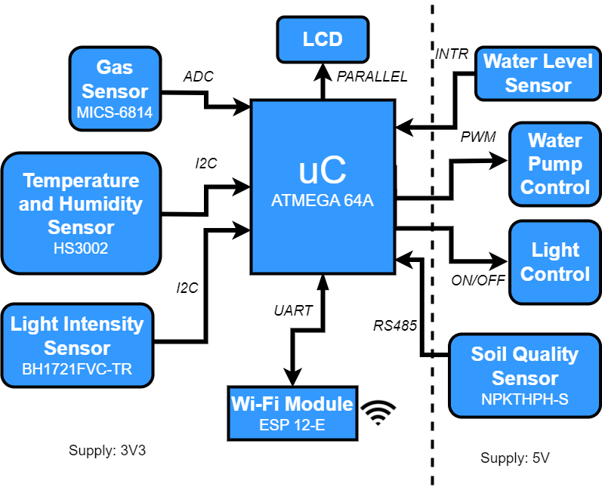
Introduction
Measured parameters:
air temperature, air humidity
light intensity
NO2, NH3, CO concentration
soil parameters (temperature, moisture, PH, Nitrogen, Phosphorus, Potassium)
Water pump and Light control
4-layer PCB
Wi-Fi communication

Slide 4
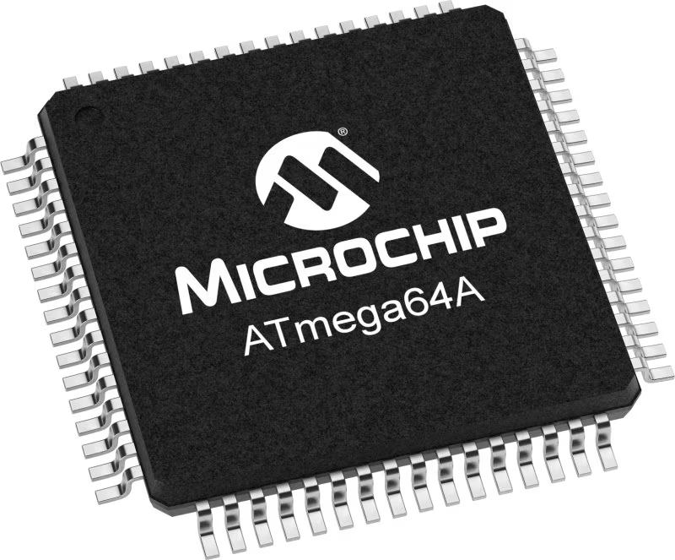
Hardware Implementation
ATmega-64A:
8-bit AVR
RISC architecture
Operating supply: 3V3
Operating frequency: 8MHz
ICSP

Slide 5
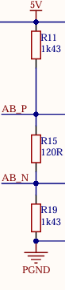
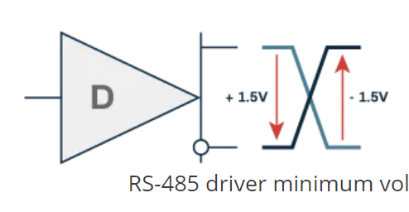
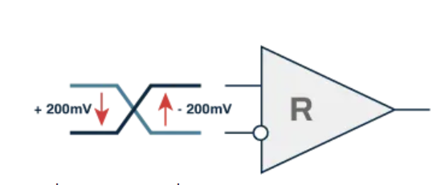
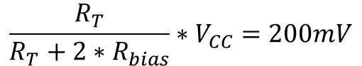
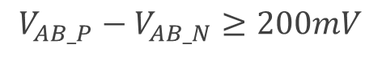
Soil Quality sensor - RS485 communication
Differential (120 Ohm), half-duplex
Fail-safe configuration:
Driver min voltages
$$V_{AB_P}−V_{AB_N}≥200mV$$
$$\frac{R_{T}}{R_{T}+2∗R_{bias}}∗V_{CC}=200mV$$
Receiver min voltages

Slide 6
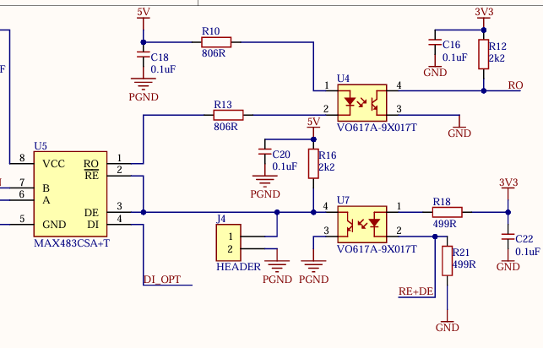
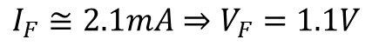
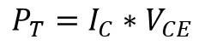
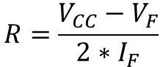
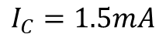
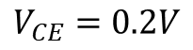
Optocoupling of RS485 communication
Transceiver MAX485
$$I_{F}≅2.1mA⇒V_{F}=1.1V$$
$$V_{CE}=0.2V$$
$$I_{C}=1.5mA$$
Symmetrical resistances to increase CMRR
$$R=\frac{V_{CC}−V_{F}}{2∗I_{F}}$$
Reduce power on the transistor
$$P_{T}=I_{C}∗V_{CE}$$

Slide 7
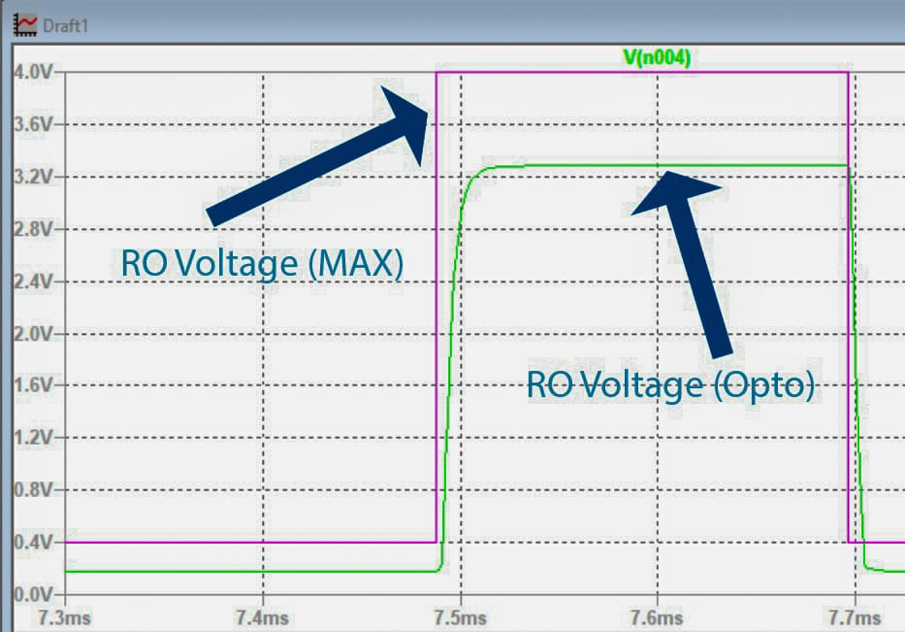
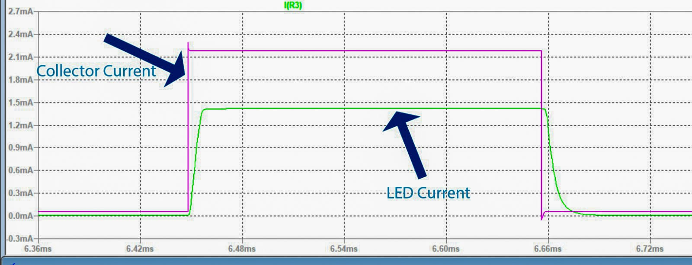
Optocoupling of RS485 communication
Simulations (for RO)

Slide 8
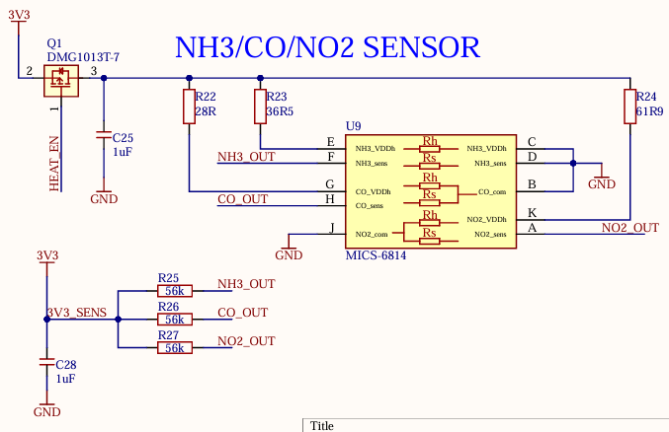
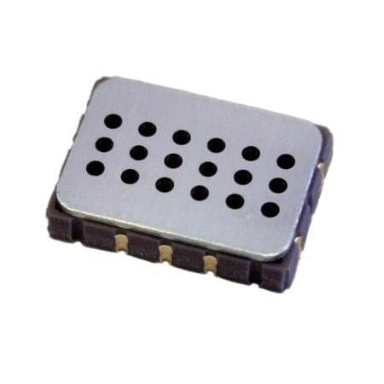
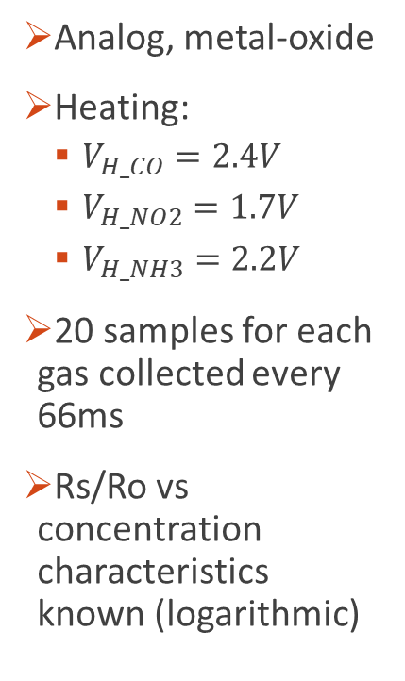
Gas concentration sensor
Analog, metal-oxide
Heating:
$V_{H_CO}=2.4V$
$V_{H_NO2}=1.7V$
$V_{H_NH3}=2.2V$
20 samples for each gas collected every 66ms
Rs/Ro vs concentration characteristics known (logarithmic)

Slide 9
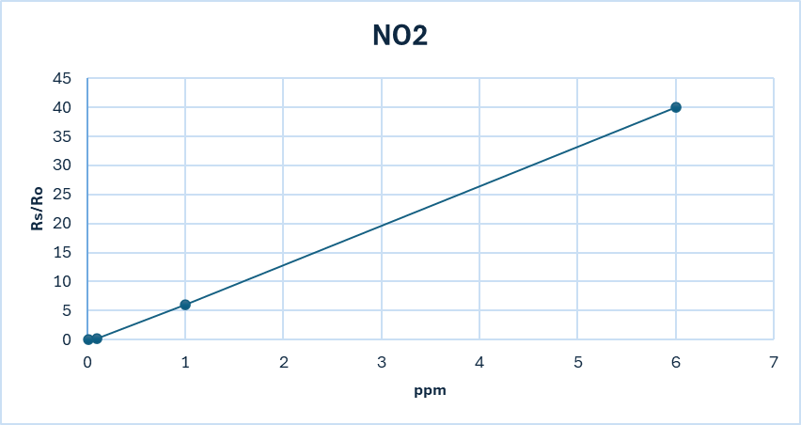
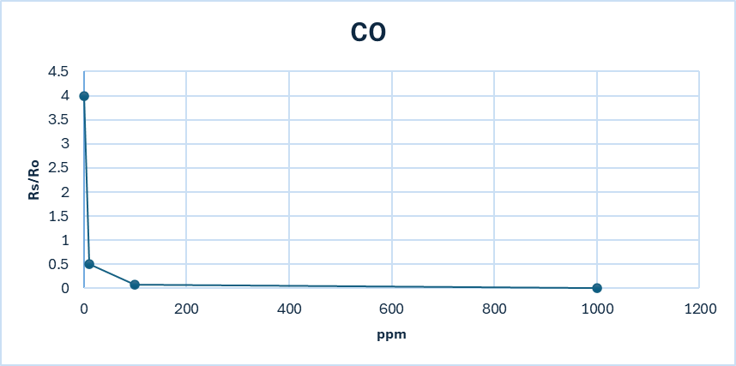
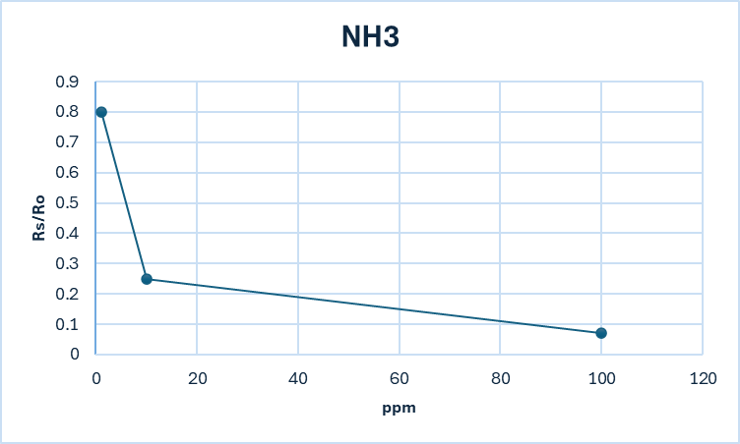
Gas concentration sensor
Linearization of Rs/Ro vs ppm characteristic
Ro_CO = 2kΩ → 8ppm
Ro_NO2 = 50.25kΩ → 0.22ppm

Slide 10
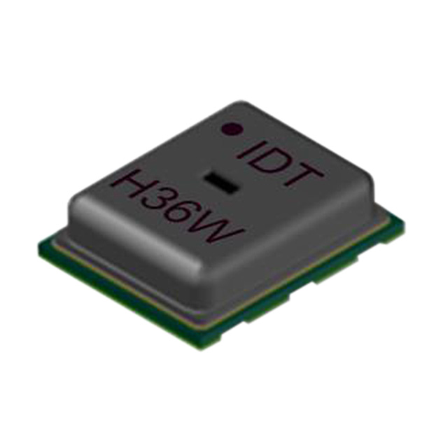
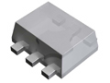
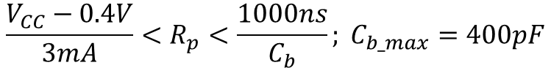
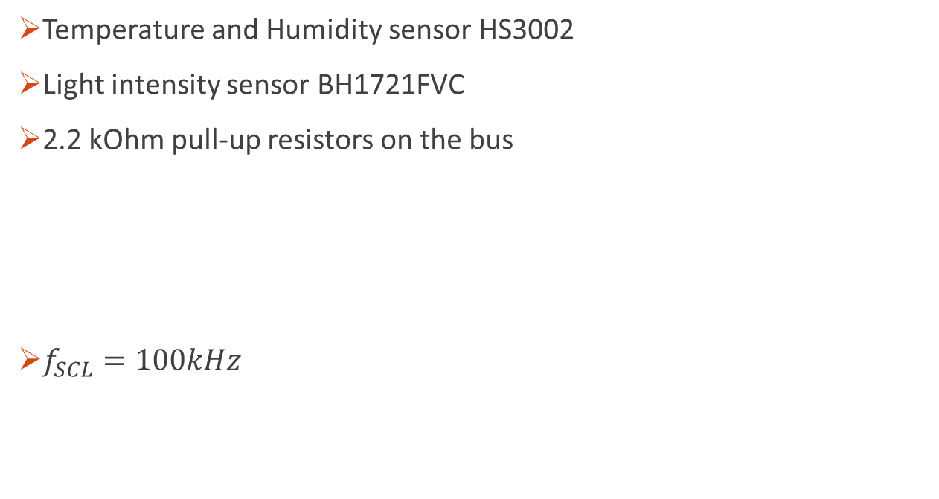
I2C sensors
Temperature and Humidity sensor HS3002
Light intensity sensor BH1721FVC
2.2 kOhm pull-up resistors on the bus
$f_{SCL}=100kHz$
HS3002
$${\frac{V_{CC}−0.4V}{3mA}<R}_{p}<\frac{1000ns}{C_{b}}; C_{b_max}=400pF$$
BH1721FVC

Slide 11
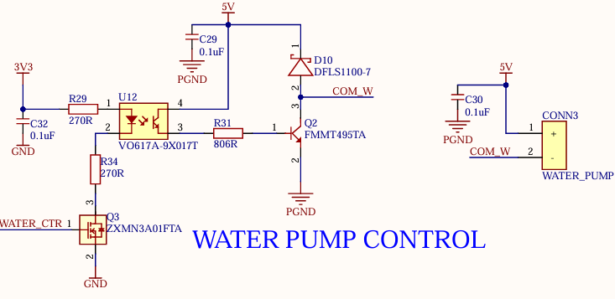
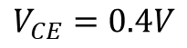
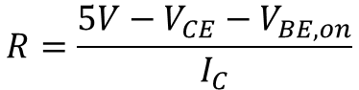
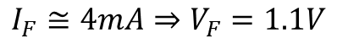
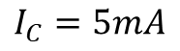
Water Pump Control
$$I_{F}≅4mA⇒V_{F}=1.1V$$
$$V_{CE}=0.4V$$
$$I_{C}=5mA$$
Resistance in the base of Q2:
Max current for the pump: 300mA
Schottky diode to reduce spikes on the transistor
$$R=\frac{5V−V_{CE}−V_{BE,on}}{I_{C}}$$
PWM command with frequency 120Hz

Slide 12
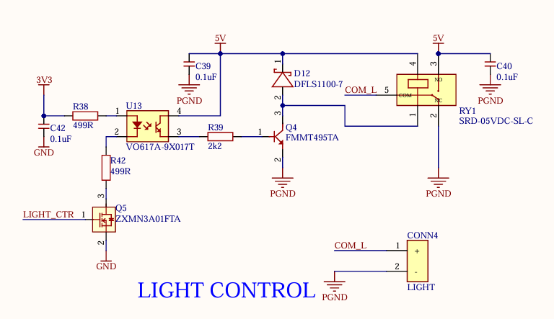
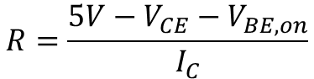
Light Control
Relay control
Resistance in the base of Q4:
$$R=\frac{5V−V_{CE}−V_{BE,on}}{I_{C}}$$

Slide 13
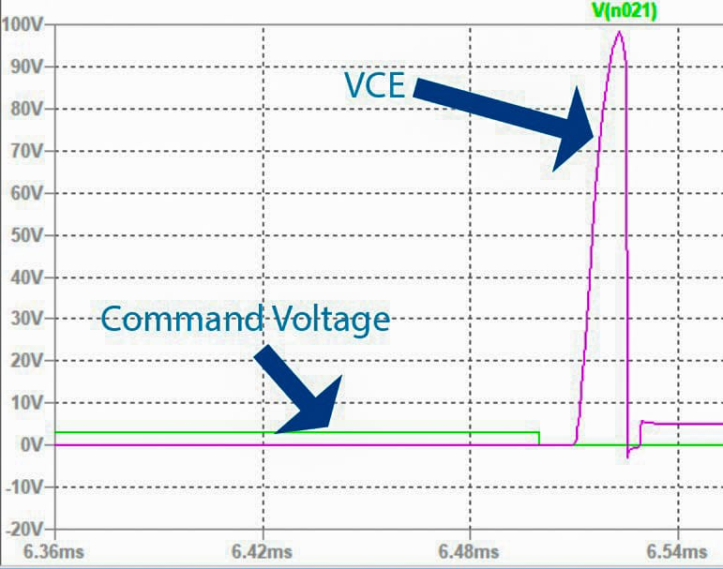
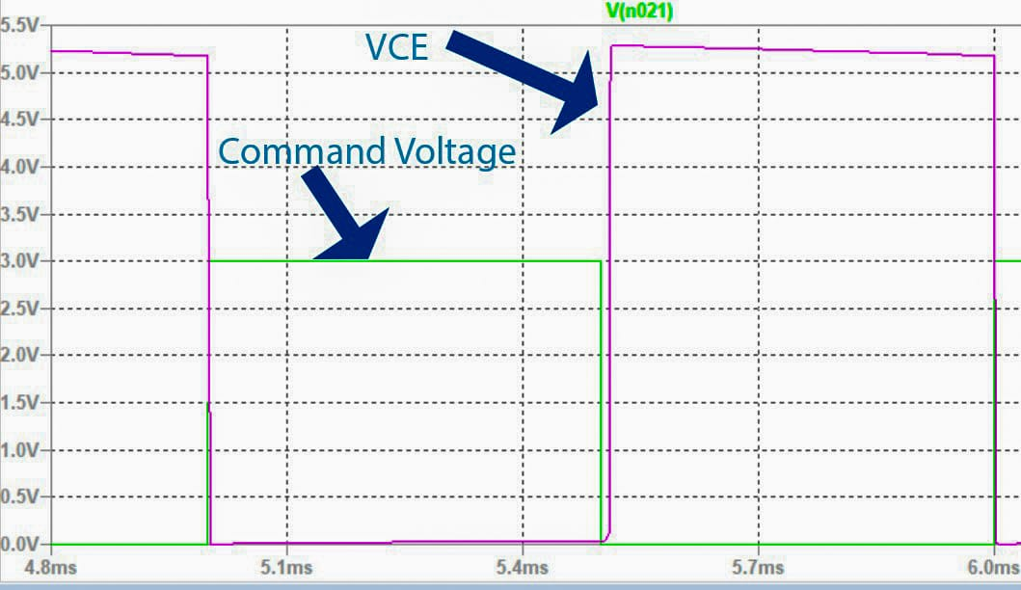
Water Pump Control and Light Control
Simulation:
Without Schottky Diode
With Schottky Diode

Slide 14
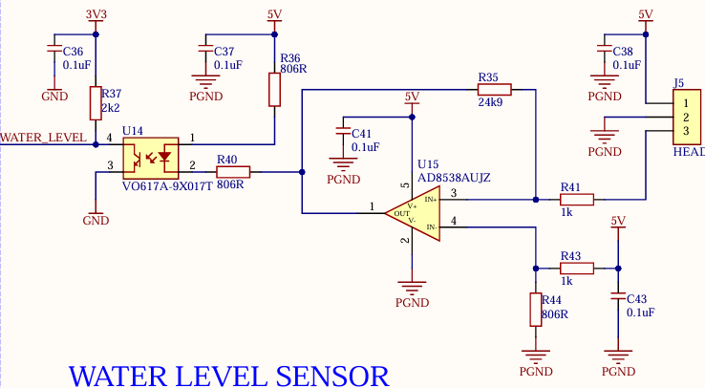
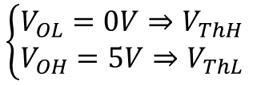
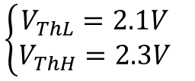
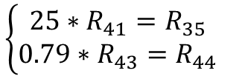
Water Level Sensor
Analog sensor (2.5V at high level)
Noninverting hysteresis comparator
After calculations:
$${\left\{\begin{aligned}V_{ThL}=2.1V \\ V_{ThH}=2.3V\end{aligned}\right.}_{}$$
$${\left\{\begin{aligned}V_{OL}=0V⇒V_{ThH} \\ V_{OH}=5V⇒V_{ThL}\end{aligned}\right.}_{}$$
$${\left\{\begin{aligned}25∗R_{41}=R_{35} \\ 0.79∗R_{43}=R_{44}\end{aligned}\right.}_{}$$

Slide 15
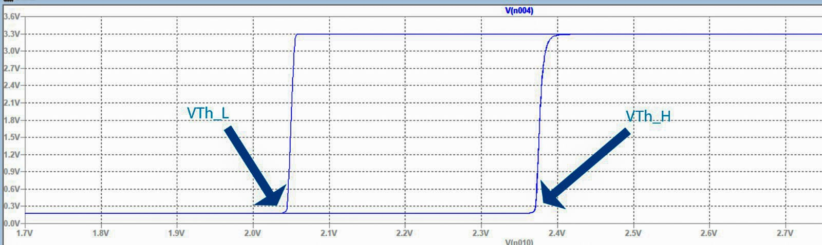
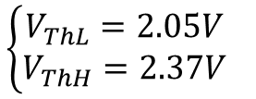
Water Level Sensor
Simulation (WATER_LEVEL vs Signal from Sensor):
$${\left\{\begin{aligned}V_{ThL}=2.05V \\ V_{ThH}=2.37V\end{aligned}\right.}_{}$$

Slide 16
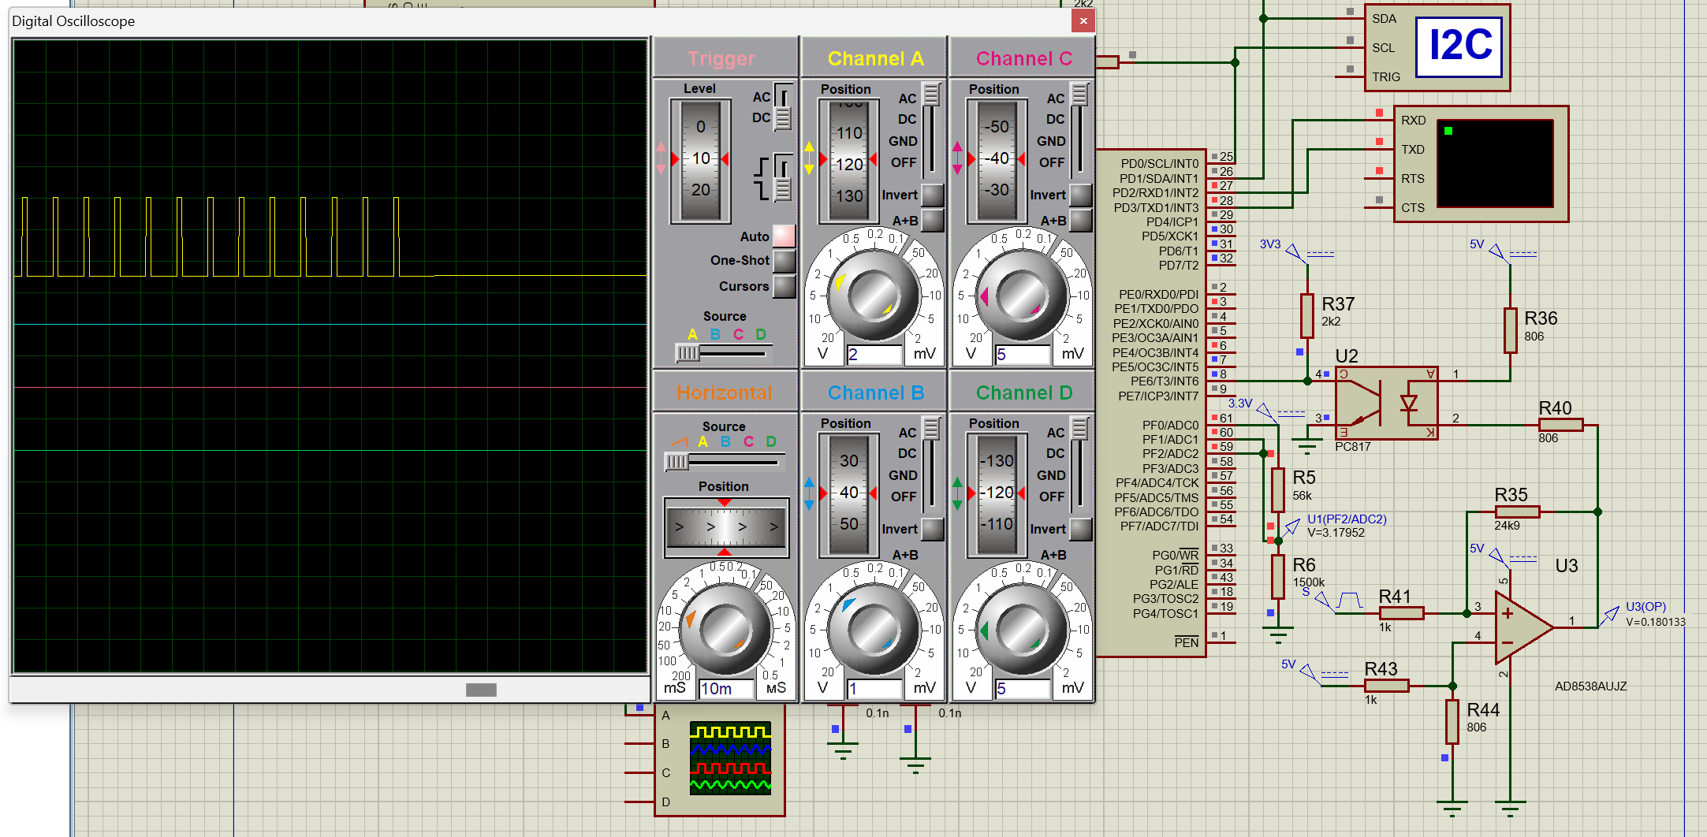
Water Level Sensor
Functioning of the external interrupt in Proteus:

Slide 17
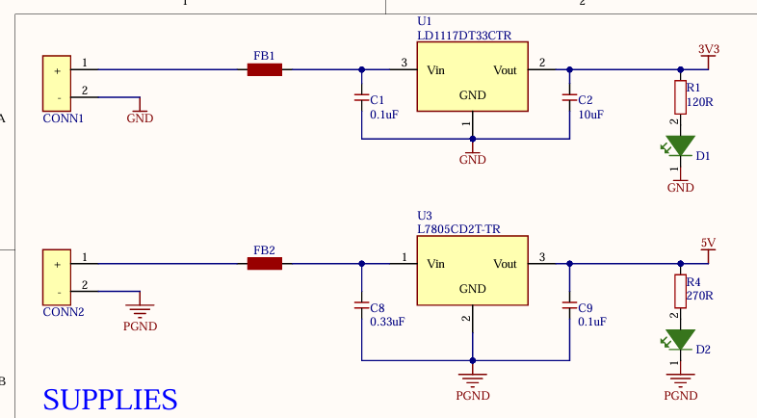
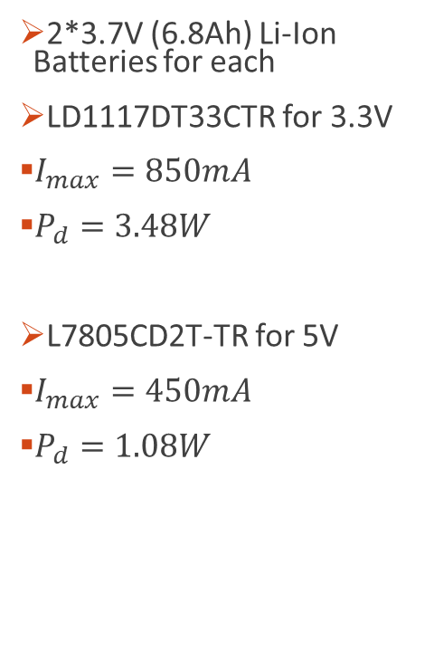
Power Supplies
2*3.7V (6.8Ah) Li-Ion Batteries for each
LD1117DT33CTR for 3.3V
$I_{max}=850mA$
$P_{d}=3.48W$
L7805CD2T-TR for 5V
$I_{max}=450mA$
$P_{d}=1.08W$

Slide 18
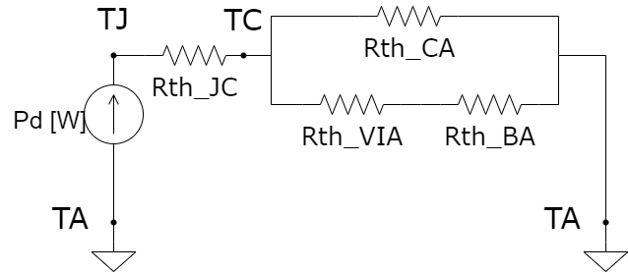
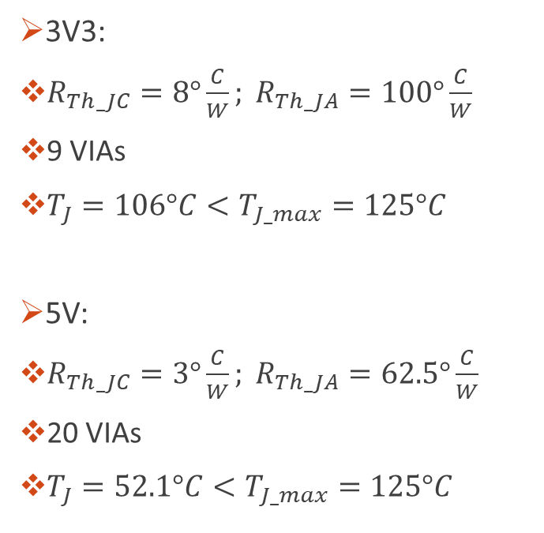
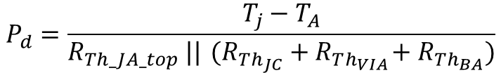
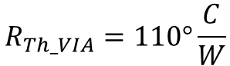
Power Supplies – Thermal design
3V3:
$R_{Th_JC}=8°\frac{C}{W}; R_{Th_JA}=100°\frac{C}{W}$
9 VIAs
$T_{J}=106°C<T_{J_max}=125°C$
5V:
$R_{Th_JC}=3°\frac{C}{W}; R_{Th_JA}=62.5°\frac{C}{W}$
20 VIAs
$T_{J}=52.1°C<T_{J_max}=125°C$
$$R_{Th_VIA}=110°\frac{C}{W}$$
$$P_{d}=\frac{T_{j}−T_{A}}{R_{Th_JA_top} ||{ (R_{Th_{JC}}+R}_{Th_{VIA}}+R_{Th_{BA}})}$$

Slide 19
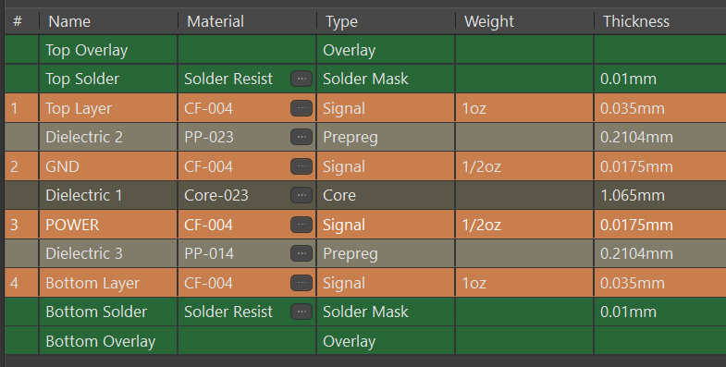
PCB design
Stack-up:

Slide 20
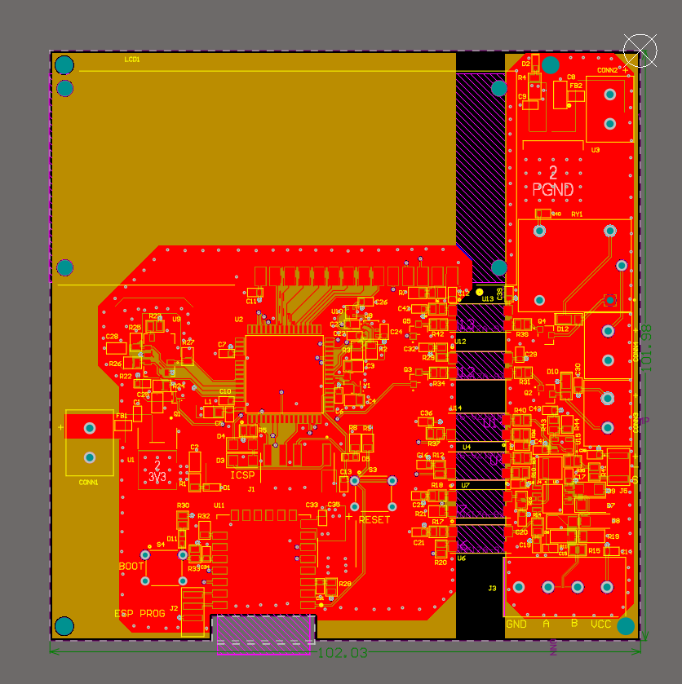
PCB design
Guarding of I2C bus and oscillator
Galvanic isolation
Signal trace width: 0.3mm (50 Ohm)
Differential pair (120 Ohm) width: 0.12mm / gap: 0.2mm
Power trace width: 0.4mm + polygons
Cut-out Area for ESP-12E
Stitching GND Vias
Bypass and decoupling capacitors

Slide 21
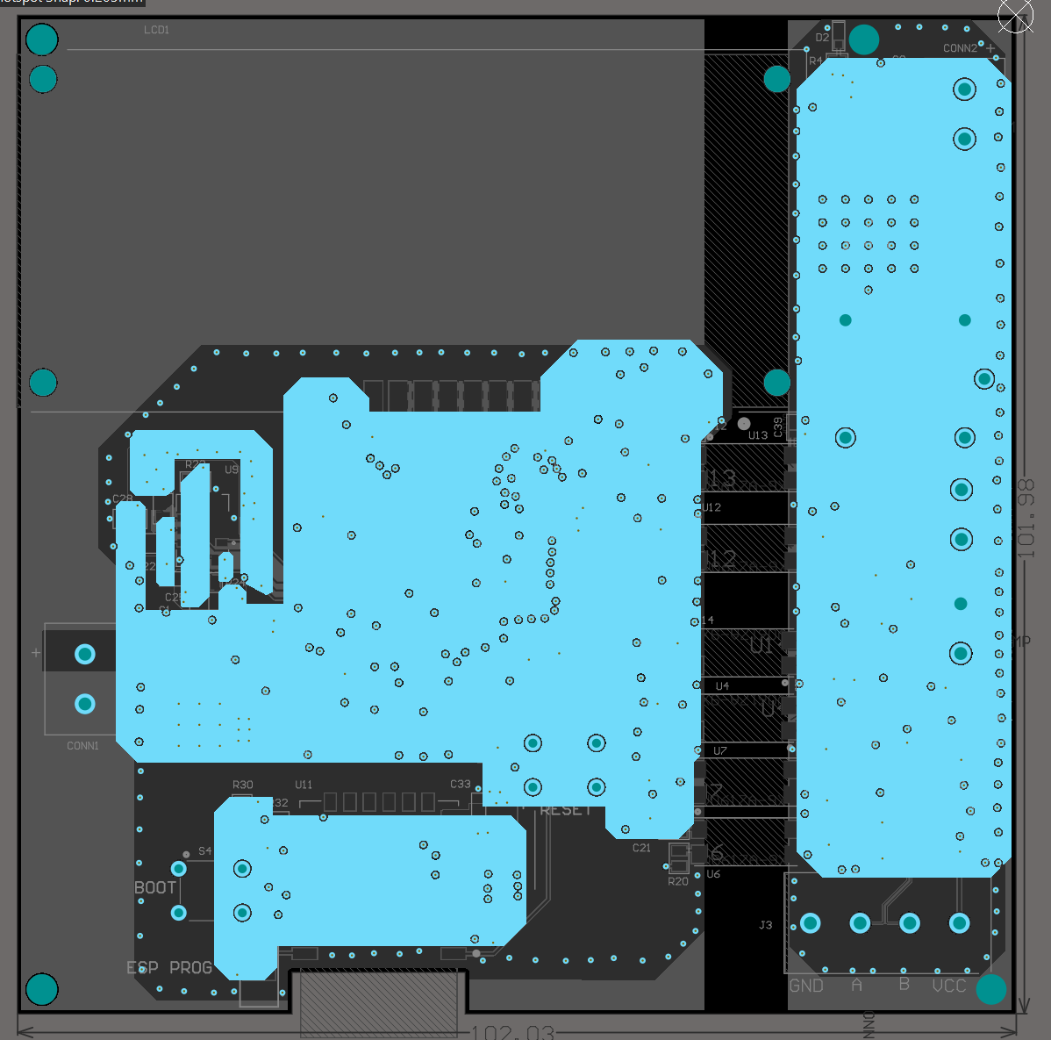
PCB design
Guarding of I2C bus and oscillator
Galvanic isolation
Signal trace width: 0.3mm (50 Ohm)
Differential pair (120 Ohm) width: 0.12mm / gap: 0.2mm
Power trace width: 0.4mm + polygons
Cut-out Area for ESP-12E
Stitching GND Vias
Bypass and decoupling capacitors

Slide 22

Software Implementation

Slide 23

Duty Cycle control
Fuzzy Logic System – Takagi-Sugeno degree 0

Slide 24


Duty Cycle control
Fuzzy Logic System – Takagi-Sugeno degree 0
Changing input sets:
Byte | Chosen desired temperature / humidity | Desired temperature / humidity used for the fuzzy controller
6 / 11 | < 20°C / < 30% | 12°C / 18%
7 / 12 | [20°C; 30°C) / [30%; 55%) | 25°C / 42%
8 / 13 | [30°C; 40°C) / [55%; 70%) | 35°C / 62%
9 / 14 | [40°C; 55°C) / $≥$ 70% | 48°C / 80%
10 | $≥$ 55°C | 77°C

Slide 25


Experimental Results
1 – LCD
2 – MICS-6814
3 – ATmega64A
4 – I2C sensors (HS3002, BH1721)
5 – ESP-12E
6 – RS-485 transceiver circuit
7 – circuit for water level sensor
8 – water pump control circuit
9 – light control circuit
10 – 5V supply (LDO and battery header)
11 – 3.3V supply (LDO and battery header)
12 – soil quality sensor
13 – water pump
14 – water level sensor

Slide 26


Experimental Results
HS3002: 64.59% humidity and 28.86°C

Slide 27


Experimental Results
BH1721: 10lx

Slide 28


Experimental Results
RS485 signals:
Data Bytes transmitted
Data Bytes received

Slide 29


Experimental Results
Water Level sensor
$${\left\{\begin{aligned}V_{ThL}=1.77V \\ V_{ThH}=2.23V\end{aligned}\right.}_{}$$

Slide 30


Experimental Results
Water Pump control

Slide 31


Experimental Results
ThingsBoard Interface
Structure of an RPC call

Slide 32
Conclusions
System used for monitoring and control
Simple system
Vital parameters for greenhouse
Accessible via Wi-Fi
From everywhere
Permanent monitoring and control
Further improvements:
More parameters to control
Solar panel supplies

Slide 33

Thank you! Q&A

